Slide 1
Campaign Planning 101

Slide 2
The Basics
Be flexible but focused on accountability
Do what works for you and your team
Create - and keep! - timelines, calendars, deadlines, etc.
Notes:
Plans should be flexible and change as campaigns intake more info, but grounded in accountability
When you’re in a campaign, no one is coming to save you - you’re on your own! This can be scary, but also freeing. Plan with purpose and hold yourself and your team accountable
Every campaign operative has their own way of producing a plan, and don’t let anyone bully you into thinking that there is one way to produce a plan. You have to know what the variables of the district/seat you’re running for are and use those according to form a strategic plan. That will look different for everyone.
BE ACCOUNTABLE. a plan is useless if it is not a living document that grows and moves with the campaign. Review and track progress frequently, stick to what’s working, change what is not.

Slide 3
Key Objectives

Slide 4
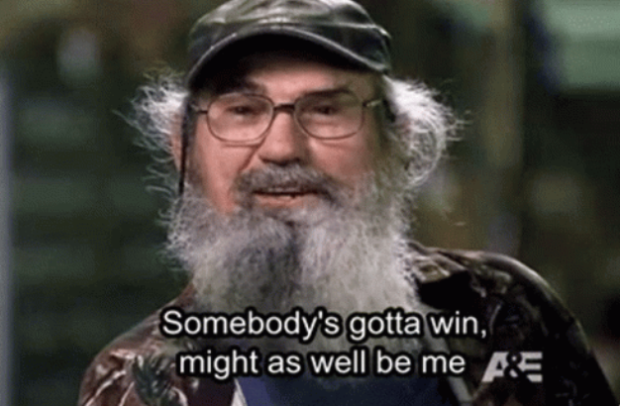
Key Objectives
Obviously number one objective - to win! But how?
Identify your win path strategy - how many doors do you need to knock by the election? Who do you need to turn out to win? How much money do you need to raise?
Use these key objectives to identify the overarching goals for your campaign.
Notes:
Of course our main goal is winning - however how exactly are you going to get there? If it’s a tough race with odds stacked against you, what other “wins” do you want to accomplish by the end of the election?
Identifying these key goals early is what everything else should flow from.
Don’t be afraid to get specific! More specific goals help identify the key steps you need to get there - don’t just say “turn out voters”, what kind of voters? Young voters? Spanish-speaking voters? New voters who haven’t voted in an election before? The answer determines the tactics you’ll need to get there.
Research is also really important at this stage - and consulting any experts you’ve been able to hire. Utilizing their industry experience with your lived experience of your district is a powerful combination.

Slide 5
Fundraising

Slide 6

Fundraising
This plan answers the most basic question - how are we going to pay!
This about who you know - and who they know as well.
Start from KREF deadlines and work backwards.
Create a “power map” of potential funders you know and build out from there.
Notes:
Money is one of the main limiting factors for what a campaign can accomplish these days - advertising, campaign lit, paid staff, yard signs, all of it comes from the money pot.
Likely one of the earliest and most critical pieces of your plan to put in place. If you are able to hire a fundraising consultant, do so early and plan with them ASAP.

Slide 7
Field + Organizing

Slide 8

Field + Organizing
This piece of the plan identifies your constituencies - or audiences - and where they fit into your overall strategy.
What’s the turf of your district look like?
Identify the “mushy middle” - who are the folks who are not die-hards for you, but also not totally set against you, this is your persuadable middle.
Notes:
Data is the name of the game with field and organizing plans, the more you have about your district, the better off you are. If you have access to VAN, use it, but also be mindful of other resources for research - previous election results data, census data, voter turnout data. Be wary of polls!
Having a good map of where critical audiences for your message are - and where you’d be wasting your time - is vital to not wasting campaign resources
At the end of the day, campaigns are in the business of getting votes - where are your most likely voters? How do you plan to reach all of them? Doorknocking is a critical piece of this of course and cutting turf for canvassing, but also community engagement is important to keep in mind here.
Ideally this is where you’ll most want to plug in volunteers when you get them - plan in such a way that if someone shows up and say they have a couple hours to knock some doors for you, you can tell them exactly where to go.

Slide 9
Communications

Slide 10
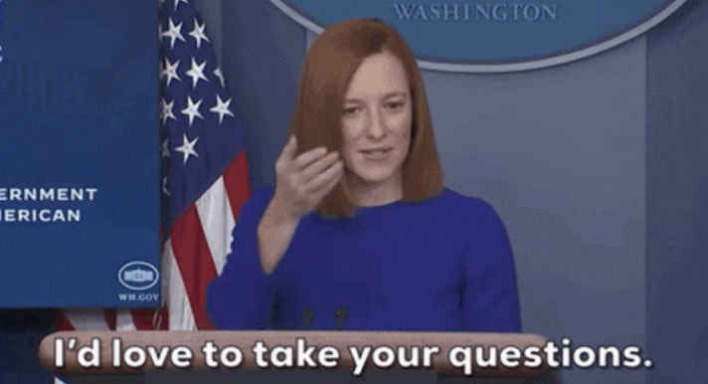
Communications
This part of the plan helps nail down key messaging points
Identify audiences and decide how you’re going to talk to them - or if you will.
Prep answers to tough questions early - you WILL get asked. Better to be prepared.
Think about how you’ll reach everyone you need to in order to win - digital comms and organizing is critical.
Notes:
Your communications planning should be less about figuring out a catchy slogan or bumper sticker and more about defining your key audiences that you need to move and how to talk to them
This relies heavily on your field and organizing strategy - that helps you define the audiences and this piece of your plan identifies how you will talk to them and reach them.
Think of all the ways you’ll be able to reach people - email, social media, digital advertising, tv and radio advertising, press (though this will be limited for small campaigns, focus on local press) - comms is an ecosystem and you cannot focus wholly on one or two methods to communicate alone
Calendaring and consistency is also critical here - work backwards from your election dates and create weekly calendars so you are keeping up a consistent messaging drumbeat.

Slide 11

Your Campaign!
Fundraising
Communications
Field + Organizing

Slide 12
Political

Slide 13

Political
This part of the plan helps identify key allies and advocates/surrogates who can help with your election.
County parties, Democratic Women’s Clubs, Young Dems, etc - but also think outside of the box.
Use a “Power map” to ID who is embedded in the constituencies you need to move by election day.

Slide 14
Don’t Forget:
Set realistic goals - and track them!
Consult experts where you don’t know answers.
Knowing your district inside and out is crucial.
Notes:
A few final takeaways:
The planning process is an iterative one and must be revisited constantly
Accountability is key - for yourself and your team. If benchmarks have been missed, identify why and if a change in strategy is needed
The planning process also forces you to put to paper what you know about your district and also what you don’t know. Use that information to empower yourself in your campaign

